Slide 1


Slide 2
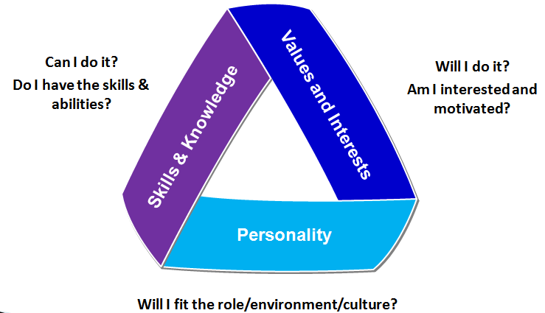
My career profile
Notes:
You know from your p view

Slide 3
Online Professional Brand/Presence
  Do you think potential employers will check your social media profiles.
  In fact 93% of them will check out a potential candidate before deciding who to hire.

Slide 4
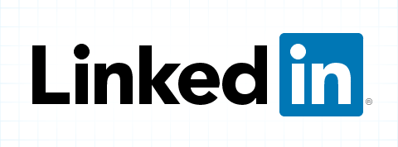
Introduction to LinkedIn -Video
https://youtu.be/UVzyLK_0i7s

Slide 5
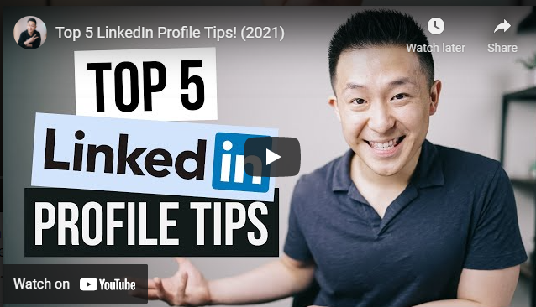
LinkedIn Profile Tips
Check out Jeff Su Top 5 LinkedIn Profile Tips.
To remove background images from your photo go to Removebg.com
To get background images for your photo including LinkedIn Banner etc. go to Canva.com
Duration 10.22min.

Slide 6
Your LinkedIn profile…
Gives you a professional online presence
Allows you to build relationships with people in your area of interest
Keeps you up to date with developments in the sector - discussions in groups
Acts as a great tool for research - individuals, career paths, companies
Helps you source advertised opportunities
Assists you in preparing for interviews

Slide 7
LinkedIn groups…
Informal communities formed around industries, professions & niche topics
Examples: DIT Graduate Network, Industry groups related to your chosen career, Professional Associations, Volunteer Groups, Country specific groups (if travelling)
  Excellent source of information
  Facilitates networking
  Group members can send each other ‘private’ messages without being connected on LinkedIn
  Group members get 4x the number of profile views

Slide 8
How can you control your online presence?
1. Check your online presence
Google themselves to see what comes up. What could they do to change the impression they’re giving so that their personal brand is as strong as possible?
2. Increase your profile
Are there other ways they could promote themselves, for example with a personal website or by writing a blog relevant to the field they want to be in?
3. Take care about what you share
Think about what they’re sharing on social media: does it fit with their personal brand? Will potential employers be impressed with what they see?

Slide 9
How can you control your online presence?
4. Associate with the right brands
Who they connect with reflects strongly on who they are, and can also help them spread awareness of their personal brand.
5. Evolve
Their personal brand will change over time, so make sure they revisit it often.

