Slide 1
Quantitative Methods
Simpson’s Rule Irregular Areas
Module No. Cons 1012
Lecturer Jennifer Byrne

Slide 2
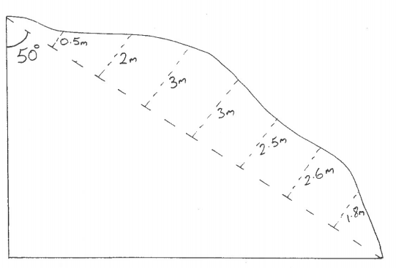
Simpson’s Rule Irregular Areas
First you need the two side lengths of the triangle in order to get area.
Then when you have established the long length (HYP) you can work out the irregular area using Simpson’s Rule.
Area =W/3 { (first + last) + 4 (evens) + 2 (odds) }
15m

Slide 3
Irregular Areas
First we need two side lengths of the triangle. Opp/Hyp
Sin 50° = 15/X
0.766 = 15/X
X = 15 ÷ 0.766
X = 19.581m
a² + b² = c²
a² = c² - b²
x² = 19.581² - 15²
x² = 383.42 - 225
x = √158.42
x = 12.586m
12.586m
19.581m
15m
Area of triangle = ½ x base x height
= 0.5 x 15 x 12.586
= 94.3987m²

Slide 4
Irregular Areas
Irregular Area = W { (first + last) + 4 (evens) + 2 (odds) } 3
= 2.448 { (0 + 0) + 4 (0.5+3+2.5+1.8) + 2 (2+3+2.6) }
3
= 2.448 { (0) + 4 (7.8) + 2 (7.6) }
3
= 2.448 { 0 + 31.2 + 15.2 }
3
= 2.448 X 46.4
3
= 37.8624m²
Total Area = 94.3987 + 37.8624 = 132.2611m²
12.586m
19.581m
15m

