Slide 1
Quantitative Methods
Trigonometry
Module No. Cons 1012
Lecturer Jennifer Byrne

Slide 2
Trigonometry
Earlier we learned what the Hypotenuse line in a triangle was. It is the longest length and it is always opposite the right angle in a right angled triangle.
It is possible to calculate the angles in any right angle triangle once you have two sides, or if you have one side and one angle you can calculate the other side.
The SIN, COS, and the TAN RULES are required once angles are involved.
These are three mathematical ratios that enable you to transfer from numbers to angles (in the triangle) and also from angles to numbers.

Slide 3
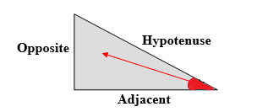
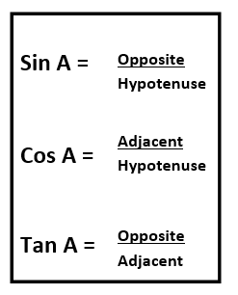
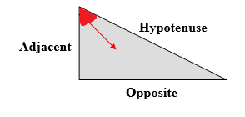
Trigonometry
You will have to decide which of the rules SIN, COS, and the TAN RULES are applied. This will depend on what information is shown.
In the same triangle, when the angle changes, the opposite and adjacent sides also change

Slide 4
Trigonometry
The HYPOTENUSE is the longest side in the triangle and is always opposite from the right-angle (It’s position never changes).
The OPPOSITE is the side that is opposite to the angle in question.
The ADJACENT is the side that is adjacent to or beside the angle in question.

Slide 5
Trigonometry
For every question only one of the formulas can be used.
To work out which formula to use you need to assess what you have and what you want.
In all cases you will have two out of the three pieces of information required.
You may be required to carry out some additional work to find the remaining angle. The three angles in a triangle add up to 180°.
30° + 60° + 90° = 180°
18° + 72° + 90° = 180°

Slide 6

Trigonometry
For every question only one of the formulas can be used.
If you have an angle starting out you will have to subject it to Sin, Cos, or Tan to calculate your answer.
If you are looking for an angle, your last line will consist of you using Inverse Sin, Inverse Cos, or Inverse Tan against a decimal figure to get your answer.
For cross multiplying purposes:
If x is below the line, swap it over
If x is above the line, just multiply it out

Slide 7
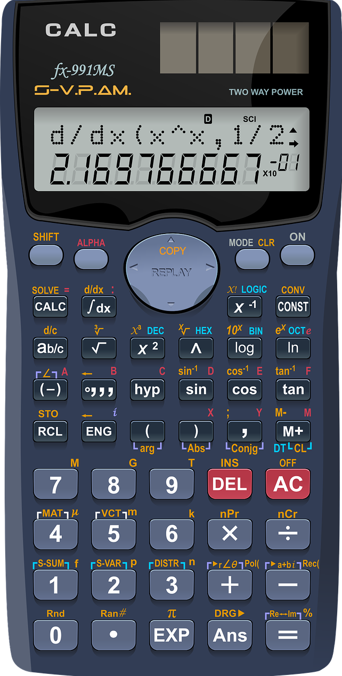
Calculators
Different models of calculators have 2nd function buttons in different places. On this model it is the SHIFT button
Make sure that you become familiar with them by carrying out simple or known calculations.
Be careful pressing the equals button too many times.
Inverse Cos or Cos¯¹ press SHIFT Cos to convert decimal number to degrees.

Slide 8
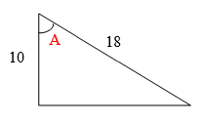


Trigonometry
Example 1: Calculate the angle at A
Which two sides do we have in relation to the angle?
Adjacent and Hypotenuse
Which formula contains these two sides?
Cosine
Cos A = (10 ÷ 18 = 0.5556)
Cos A = 0.5556
Cosˉ ¹ A = 56.247 degrees (inverse of Cos)
A = 56.25°

Slide 9
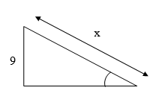



Trigonometry
Example 2: Calculate the length of the unknown side if the given angle is 34°
Which two sides do we have in relation to the angle?
Opposite and Hypotenuse
Which formula contains these two sides?
Sine
Sine 34° = (sin 34° = 0.5592)
0.5592 =
X =
X = 16.0944

Slide 10
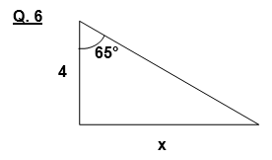
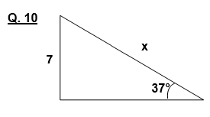
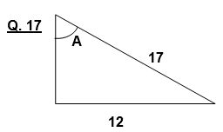
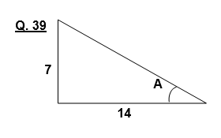
Trigonometry
Find the Unknown Angle or Side Length

Slide 11
Solutions
Tan 65° = X/4
2.145 = X/4
2.245 x 4 = X
Answer = 8.578
Sin 37° = 7/X
0.6018 = 7/X
X = 7/0.6018
Answer 11.63

Slide 12
Solutions
Sin A = 12/17
Sin A = 0.7059
Sin¯¹ A = 44.901
Answer = 44.9°
Tan A = 7/14
Tan A = 0.5
Tan ¯¹ A = 26.565
Answer 26.57°

