Slide 1
Quantitative Methods
Simpson’s Rule Volume
Module No. Cons 1012
Lecturer Jennifer Byrne

Slide 2
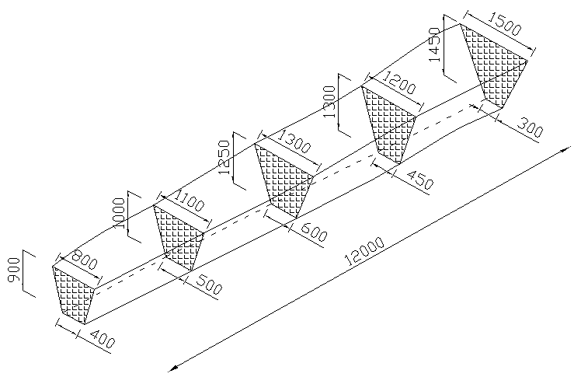
Simpson’s Rule Volume
Simpson’s Rule is used to calculate the area of an irregular surface.
The surface is measured using Ordinates (or Lengths).
For Simpson’s Rule for Volume first you need to calculate the cross sectional areas at the ordinates at regular intervals .
Once you have calculated these you can then insert into the formula.
Area =W/3 { (first + last) + 4 (evens) + 2 (odds) }
All measurements are in mm

Slide 3
Simpson’s Rule Volume
Calculate the volume of soil required to backfill the excavated trench shown using Simpson’s rule for volume.
Before being compacted into the trench, the loose soil is bulked by 35%, so what is the actual bulked volume of soil required?
Area =W/3 { (first + last) + 4 (evens) + 2 (odds) }
5
4
3
2
1
All measurements are in mm

Slide 4
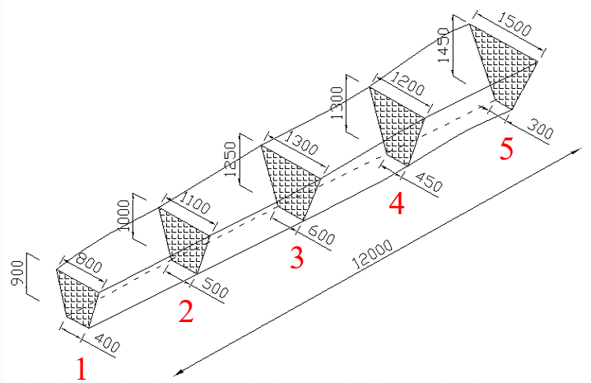
Simpson’s Rule Volume
First calculate cross sectional areas
using the trapezoid formula:{ a + b } x height
2
Cross sectional area (1) { 0.8 + 0.4 } x 0.9 = 0.54 m² 2
Cross sectional area (2) { 1.1 + 0.5 } x 1.0 = 0.80 m² 2
Cross sectional area (3) { 1.3 + 0.6 } x 1.25 = 1.1875 m² 2
Cross sectional area (4) { 1.2 + 0.45} x 1.3 = 1.0725m² 2
Cross sectional area (5) { 1.5 + 0.3 } x 1.45 = 1.305 m² 2
All measurements are in mm

Slide 5
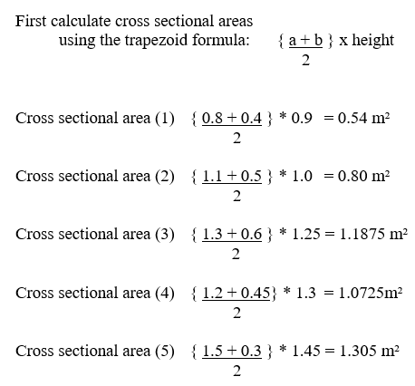
Simpson’s Rule Volume
All measurements are in mm

Slide 6
Simpson’s Rule Volume
Simpsons Rule = W { (first + last) + 4 (evens) + 2 (odds) } 3
= 3 { (0.54 + 1.305) + 4(0.8+1.0725) + 2(1.1875) } 3
= 1 { (1.845) + 4(1.8725) + 2(1.1875) }
= 1 { 1.845 + 7.49 + 2.375 }
= 1 x 11.71
= 11.71 m³
Bulking:11.71 x 1.35 = 15.8085 m³
All measurements are in mm

