Slide 1
Quantitative Methods
Percentages Differences
Module No. Cons 1012
Lecturer Jennifer Byrne

Slide 2
Percentage Difference
To find the percentage difference:
Divide by what you have and multiply by what you want
Eg : if 45% of the cost of a chair is €90. What is the total cost?
90 x 100 = €200 or 90 ÷ 45 x 100 = €200 45 1
Example 1 If 70% is €3150 what is 100%
3150 ÷ 70 = 45
45 x 100 = €4500
Example 2 If 64% = €96 what is 38%
96 ÷ 64 = 1.5
1.5 x 38 = €57

Slide 3
Percentage Difference
To find the percentage difference:
Divide by what you have and multiply by what you want
Example 3 If 326.25 includes 45% what is 100%
326.25 ÷ 145 = 2.25
2.25 x 100 = €225
Example 4 If I bought a table for x amount and sold it for €552 making a profit of 20%. What price did I pay for the table.
Table : 552 = 120%
552 ÷ 120 = 4.6 divide by 120 to find 1%
4.6 x 100 = €460 multiply by 100

Slide 4
Percentage Difference Questions
Q5. If a Dealer bought a Van for €6500 and sold it for €7800 what percentage profit did he make.
7800 – 6500 = 1300 difference
1300 ÷ 6500 (0.2) x 100 = 20% profit
To check 6500 + 20% (1300) = €7800
Q6. If a mistake in pricing resulted in windows costing €1250 being sold at €1125 calculate the percentage loss
1250 – 1125 = 125 difference
125 ÷ 1250 (0.1) x 100 = 10% loss
To check 1250 – 10% (125) = €1125

Slide 5
Percentage Difference Questions
Q7. If a door and frame costs €420 to make and is sold for €525 calculate the percentage profit
525 – 420 = 105 difference
105 ÷ 420 (0.25) x 100 = 25% profit
To check 420 + 25% (105) = €525
Q8. A Contractor priced a job at €97,500. The cost of the job on completion was €105,300 . Calculate the percentage loss
105,300 – 97,500 = 7800 difference
7,800 ÷ 97,500 (0.08) x 100 = 8%
To check 97,500 + 8% (7800) = €7800

Slide 6
Percentage Questions Worksheet 3
Q4. When soil is excavated its bulk volume increases. This is known as bulking. Calculate the total (increased) volume of soil allowing for bulking @ 25% when the calculated volume of the excavation is 52.8m³.
Q. 4 52.8m³ x 1.25 = 66m³
Same as
52.8m³ + 25% = 66m³

Slide 7
Percentage Questions Worksheet 3
Q 5. 18 full truckloads of soil are excavated from a foundation trench. Calculate the volume of the trench when each truckload is an average of 24m³ (after bulking) and bulking of soil is estimated at 25%.
Q. 5 18 x 24 = (432m³ / 125) x 100 = 345.6m³
Same as
24 = 125%
24 ÷ 125 x 100 = 0.192 X 18 =345.6m³
24 ÷ 125 x 100 X 18= 345.6m³

Slide 8
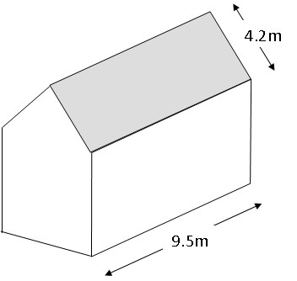
Percentage Questions Worksheet 3
Q. 1 Calculate the area of the pitched roof shown (both sides) and determine the number of slates required if 1m² takes 13.3 slates. (Add 15% for eaves overhang, cutting and waste)
Q. 1 9.5 x 4.2 x 2 = 79.8m²
79.8 x 13.3 = 1061.34 slates
1061.34 x 1.15 = 1220.541
Ans = 1221 slates
0r
9.5 x 4.2 x 2 = 79.8m²
79.8 + 15% = 91.77m²
91.77 X 13.3 = 1220.541
Ans = 1221 slates

Slide 9
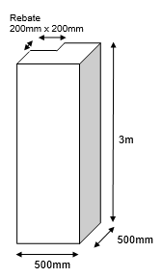
Percentage Questions Worksheet 3
Q. 2 (a) Calculate the volume of concrete required to fill this rebated column
(b) If concrete is charged at € 95 per m³ Calculate the cost. (Apply VAT at 13.5%)
Q. 2 Volume = 3 x 0.5 x 0.5 = 0.75m³
Less 3 x 0.2 x 0.2 = 0.12
0.63 m³
x €95.00
€59.85
€59.85 x 1.135 = €67.92975
Ans = €67.93

