Slide 1
Quantitative Methods
Simpson’s Rule
Module No. Cons 1012
Lecturer Jennifer Byrne

Slide 2
BOMDAS Rule
BOMDAS is an acronym for remembering the order in which you work out mathematical formulas.
Brackets, Order, Multiplication/Division, Addition/Subtraction
Another version is BOMDAS or BIDMAS
or BIDMAS where I stands for Indices power of 2, 3 etc.
Khan Academy A non-profit with the mission to provide a free, world-class education for anyone, anywhere.

Slide 3
Simpson’s Rule
Simpson’s Rule is used to calculate the area of an irregular surface.
The surface is measured using Ordinates (or Lengths).
The Ordinates are measured at regular intervals along the baseline and at right angles to it.
There should always be an uneven number of ordinates.
Area =W/3 { (first + last) + 4 (evens) + 2 (odds) }
W = width of each section (should be equal widths)
(first + last) = the first ordinate + last ordinate
4 (evens) = 4 x (the sum of all of the even ordinates)
2 (odds) = 2 x (the sum of all of the odd ordinates)
Do Not include the first and last ordinate again with the odds ordinates.

Slide 4
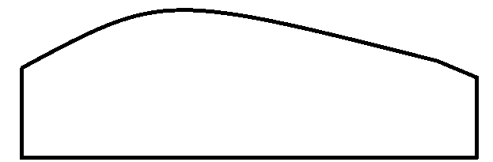
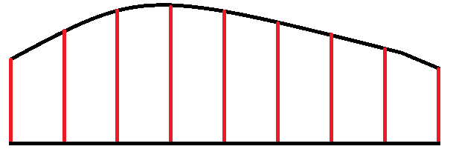
Simpson’s Rule
There should always be an uneven number of ordinates.
Area =W/3 { (first + last) + 4 (evens) + 2 (odds) }
W = width of each section (should be equal widths)
(first + last) = the first ordinate + last ordinate
4 (evens) = 4 x (the sum of all of the even ordinates)
2 (odds) = 2 x (the sum of all of the odd ordinates)
Here we would divide by 8 to get even widths: 18 ÷ 8 = 2.25
18m

Slide 5
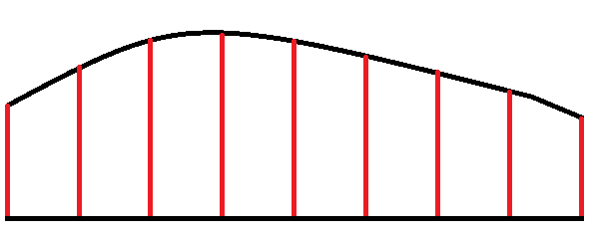
Simpson’s Rule
There should always be an uneven number of ordinates.
Area =W/3 { (first + last) + 4 (evens) + 2 (odds) }
W = 18m ÷ 8 = 2.25m
(first + last) = 4 + 3.75 =
4 (evens) = 4 x (5 + 6 + 5 + 4) =
2 (odds) = 2 x (5 + 5 + 4.5) =
1 2 3 4 5 6 7 8 9
2.25/3 (7.75 + 80 + 29) =
2.25/3 (116.75) = 87.56m²
7.75
80
29
4m
5m
5m
6m
5m
5m
4.5m
4m
3.75m
18m

Slide 6
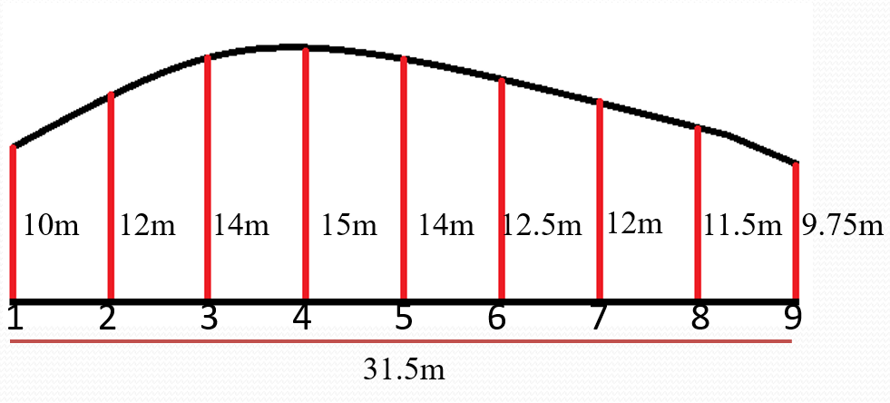
Question 1.
There should always be an uneven number of ordinates.
Area =W/3 { (first + last) + 4 (evens) + 2 (odds) }
Calculate the area below.
First find W
9 ordinates means 8 spaces so 31.5m ÷ 8 = 3.94m

Slide 7
Simpson’s Rule
There should always be an uneven number of ordinates.
Area =W/3 { (first + last) + 4 (evens) + 2 (odds) }
W = 31.5m ÷ 8 = 3.94m
(first + last) = 10 + 9.75 =
4 (evens) = 4 x (12 + 15 + 12.5 + 11.5) =
2 (odds) = 2 x (14 + 14 + 12) =
1 2 3 4 5 6 7 8 9
3.94/3 (19.75 + 204 + 80) =
3.94/3 (303.75) = 398.925m²
19.75
204
80
10m
12m
14m
15m
14m
12.5m
12m
11.5m
9.75m
31.5m

